Slide 1

WEEK 5 · LECTURE 10 · THURSDAY
Finding the Themes in the Pile
Topic modeling with embeddings
The machine finds the clusters. You name them.
ISBA 2411 · Natural Language Processing & AI · Summer 2026

Slide 2

THE PROBLEM
5,000 reviews. Nobody labeled them.
You can't read them all, and counting words misses meaning.
ISBA 2411 · Natural Language Processing & AI · Summer 2026
2

Slide 3
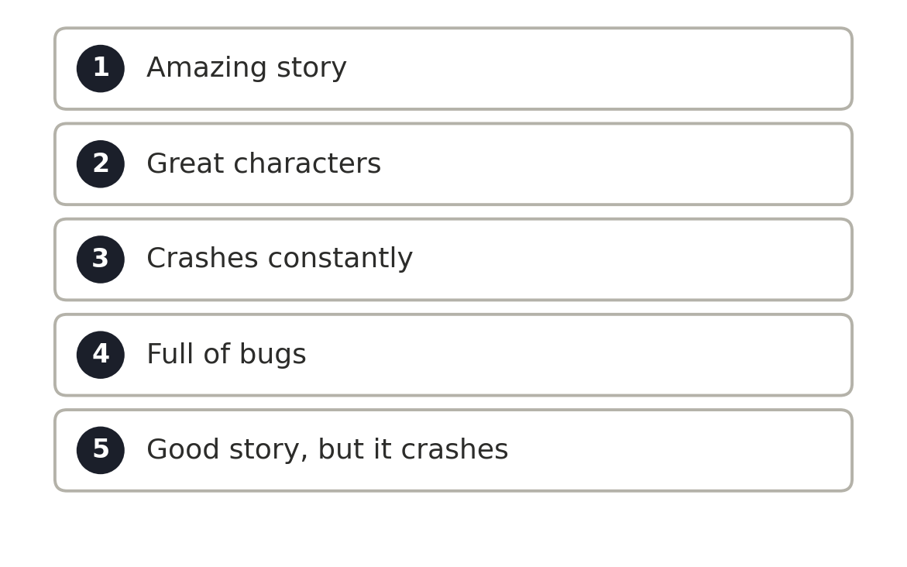
THE PLAN
So let's follow just five.
Small enough to watch every step by hand, then we scale up to the whole pile.
ISBA 2411 · Natural Language Processing & AI · Summer 2026
3

Slide 4
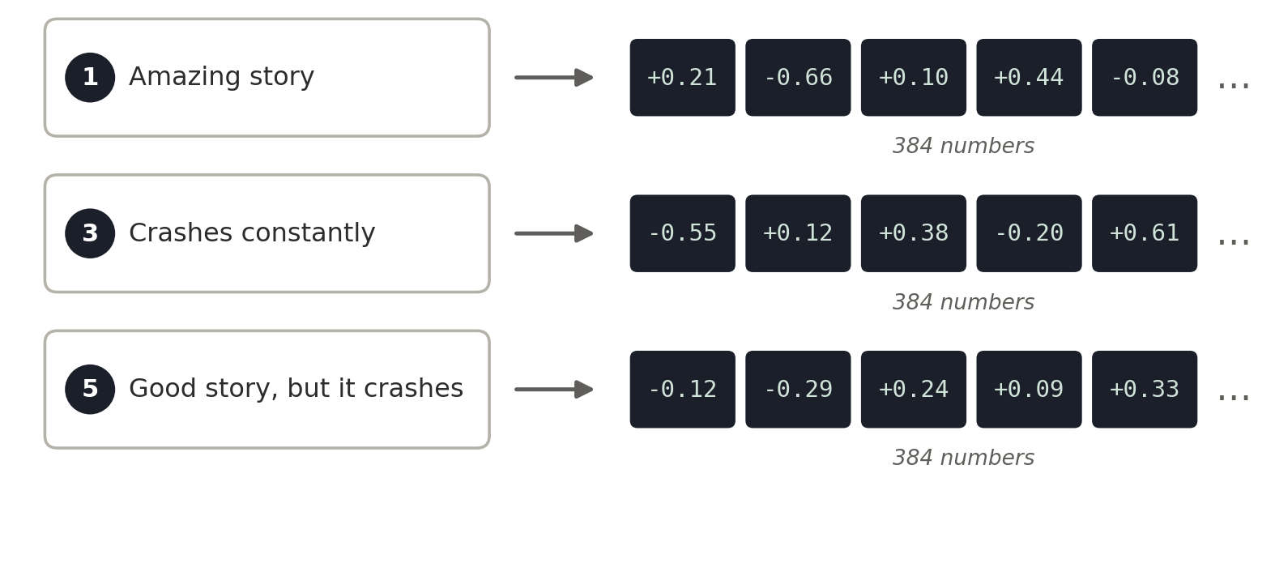
Embed
›
Reduce
›
Cluster
›
Label
›
Name
Every review becomes a list of numbers.
A pretrained sentence-transformer maps text to a 384-dim vector in meaning-space.
UNDER THE HOOD emb = model.encode(reviews) # 384-dim
Sentence-BERT · Reimers & Gurevych 2019
ISBA 2411 · Natural Language Processing & AI · Summer 2026
4

Slide 5
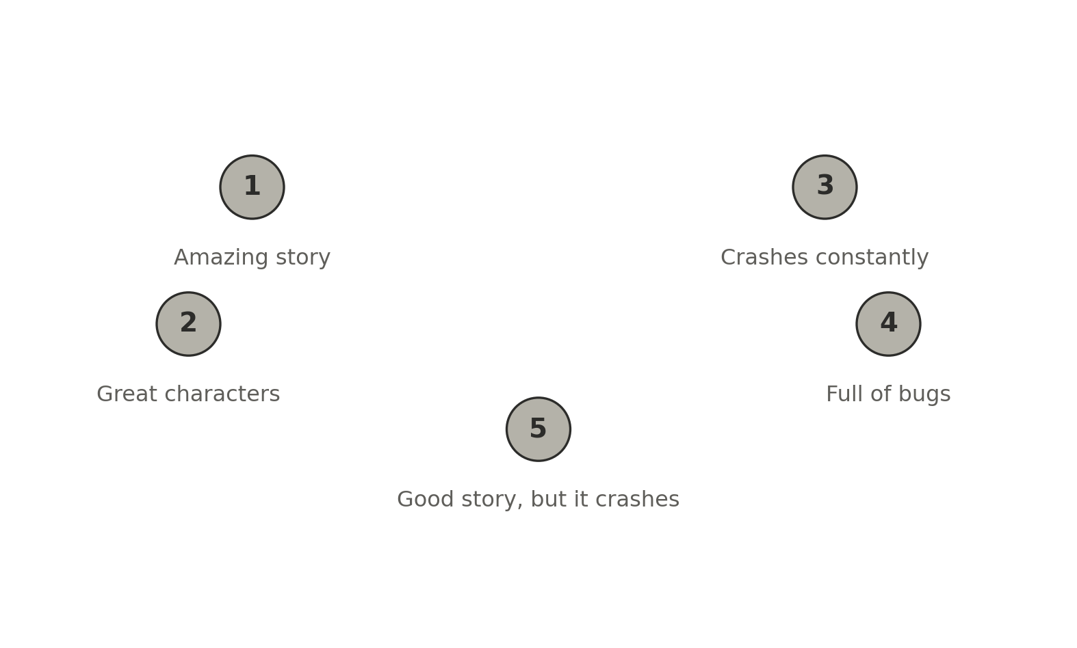
Embed
›
Reduce
›
Cluster
›
Label
›
Name
Similar meaning lands nearby.
Cosine similarity is high within a theme; to see it, we reduce 384-dim to 2-D.
UNDER THE HOOD cos_sim(a, b) · UMAP(n_neighbors=15)
UMAP · McInnes, Healy & Melville 2018
ISBA 2411 · Natural Language Processing & AI · Summer 2026
5

Slide 6
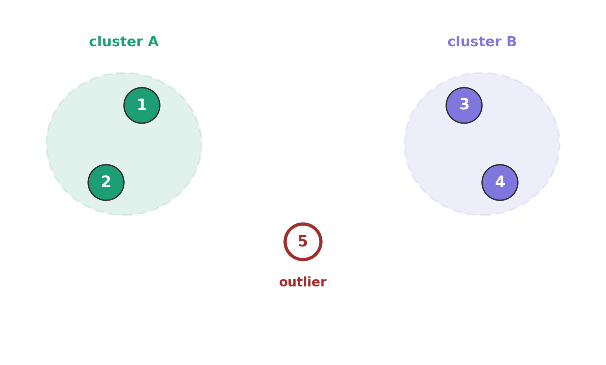
Embed
›
Reduce
›
Cluster
›
Label
›
Name
The clusters appear, and one doesn't fit.
Density clustering finds the groups and leaves borderline points as noise (-1).
UNDER THE HOOD HDBSCAN(min_cluster_size=15) # toy: KMeans(2)
HDBSCAN · Campello 2013 · McInnes 2017
ISBA 2411 · Natural Language Processing & AI · Summer 2026
6

Slide 7
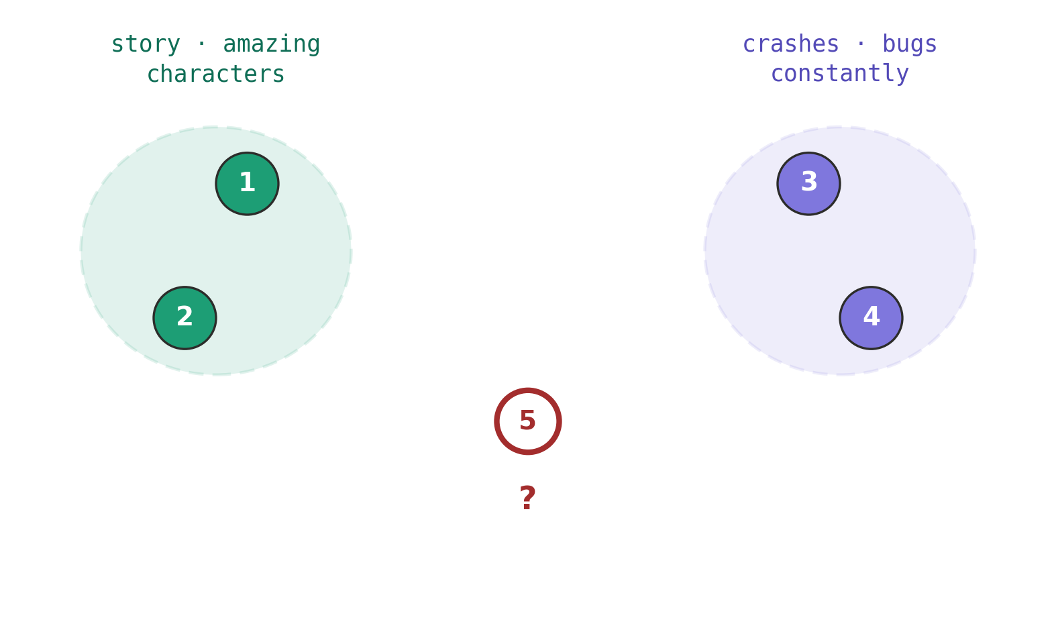
Embed
›
Reduce
›
Cluster
›
Label
›
Name
Each cluster is just a list of words.
c-TF-IDF scores which words are most distinctive to each cluster.
UNDER THE HOOD topic_model.get_topic(k) # c-TF-IDF terms
c-TF-IDF · Grootendorst 2022
ISBA 2411 · Natural Language Processing & AI · Summer 2026
7

Slide 8
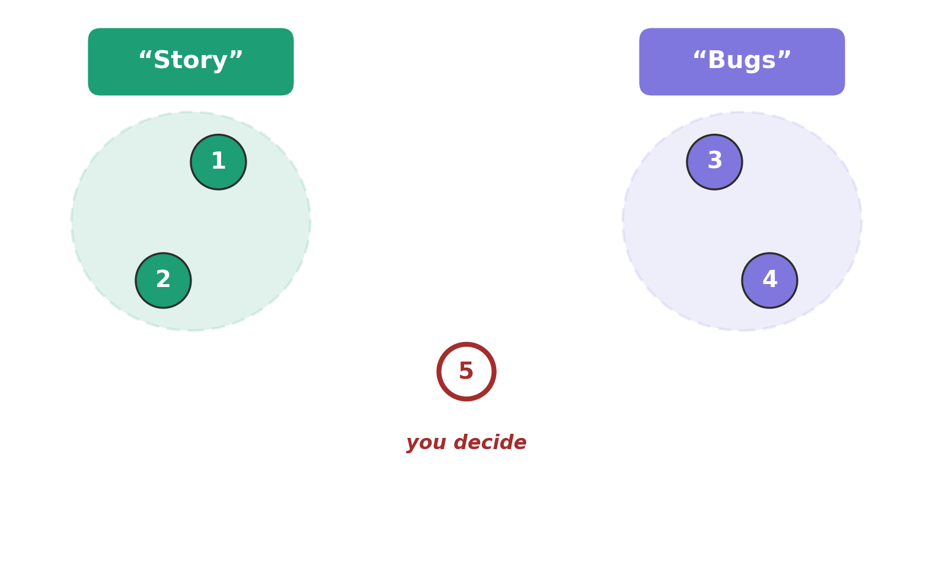
Embed
›
Reduce
›
Cluster
›
Label
›
Name
You write the label.
The pipeline hands you words. A human reads them, checks a few examples, and writes the topic name.
UNDER THE HOOD set_topic_labels({0:"Story", 1:"Bugs"})
the last box is yours · Grootendorst 2022
ISBA 2411 · Natural Language Processing & AI · Summer 2026
8

Slide 9
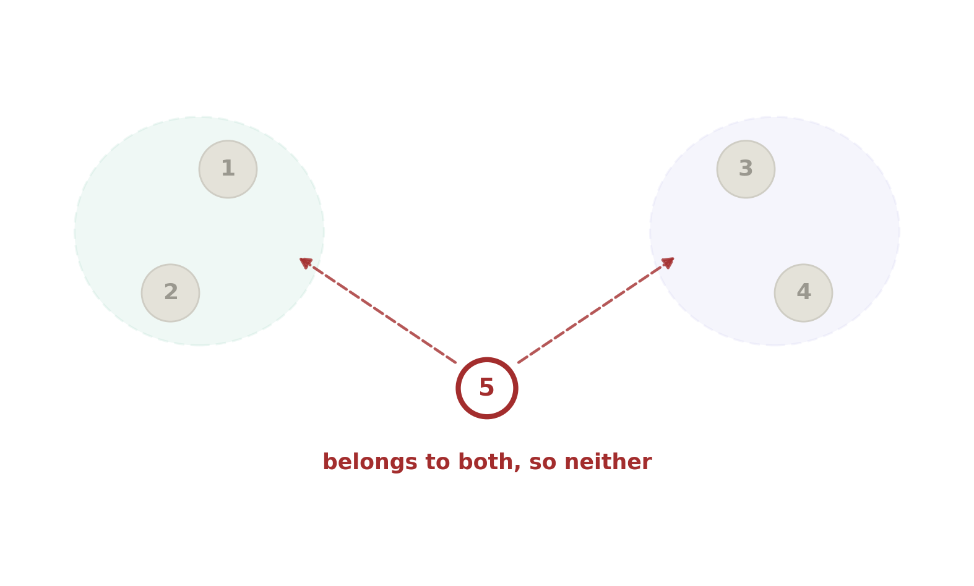
THE CATCH
Some reviews fit no clean theme.
HDBSCAN collects torn cases in the -1 bucket. A tidy word-list can still be junk.
UNDER THE HOOD topics == -1 # outlier / noise bucket
density clustering · McInnes 2017
ISBA 2411 · Natural Language Processing & AI · Summer 2026
9

Slide 10
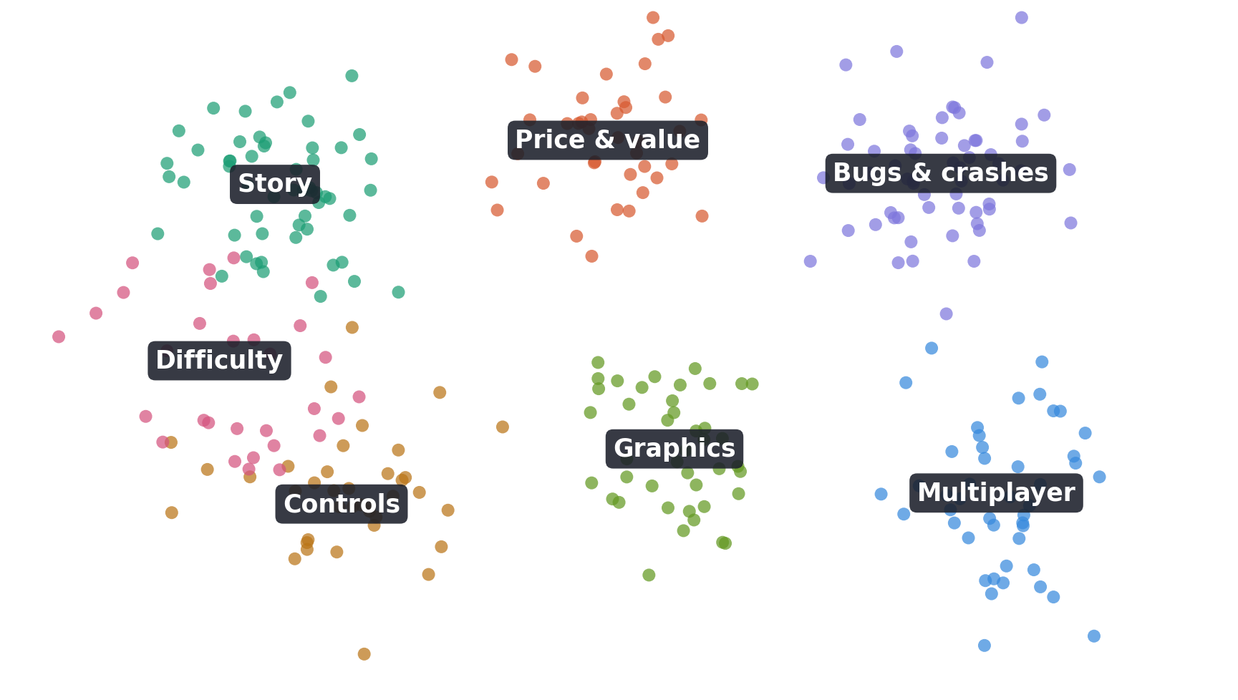
Embed
›
Reduce
›
Cluster
›
Label
›
Name
One button does all 5,000.
BERTopic chains embed, reduce, cluster, and c-TF-IDF into a single call.
UNDER THE HOOD BERTopic().fit_transform(docs)
BERTopic · Grootendorst, arXiv:2203.05794
ISBA 2411 · Natural Language Processing & AI · Summer 2026
10

Slide 11
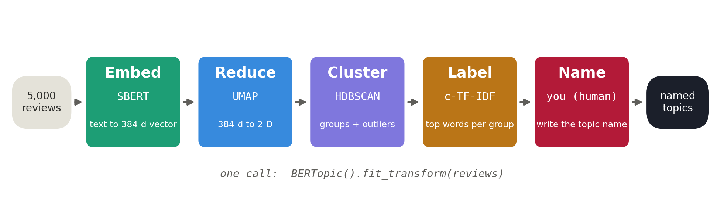
THE WHOLE PIPELINE
Four algorithms, then you.
Everything you just did, end to end. BERTopic chains the first four steps; the last one is yours.
UNDER THE HOOD reviews -> SBERT -> UMAP -> HDBSCAN -> c-TF-IDF -> you
the map for tonight and for your project
ISBA 2411 · Natural Language Processing & AI · Summer 2026
11

Slide 12
YOUR TURN
30 MINUTES
Name the themes. Flag the junk.
In your final project team, one laptop. Open the notebook and scroll to Part C: your six cards are already there.
1
2
3
Name all six
Find the junk
Find a mis-file
Read the top words. Write a name a product team could actually act on.
One of the six is incoherent. Which one, and how could you tell?
One review sits in the wrong topic. Quote it, and say where it belongs.
All three go in your team's row of the sheet. Link: top and bottom of the notebook. Worked example in the first row.
TWO RULES Don't run the cells at the very bottom, they're the answer key. · Don't just split the six between you: argue about at least one, out loud.
ISBA 2411 · Natural Language Processing & AI · Summer 2026
12

Slide 13
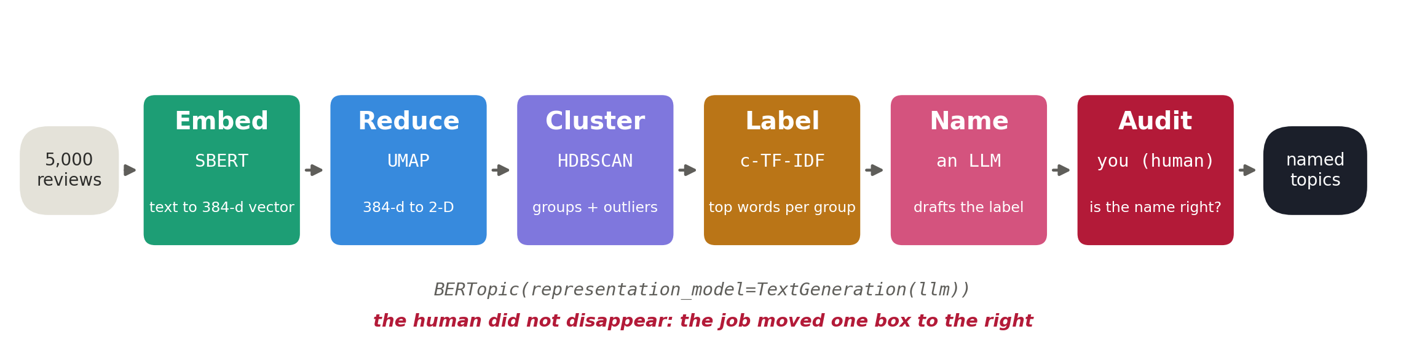
NOW LET THE MACHINE TRY
Can it write the names too?
An LLM reads the same words and the same examples, and drafts every label in about a second.
UNDER THE HOOD BERTopic(representation_model=TextGeneration(llm))
representation models · Grootendorst 2022
ISBA 2411 · Natural Language Processing & AI · Summer 2026
13

Slide 14
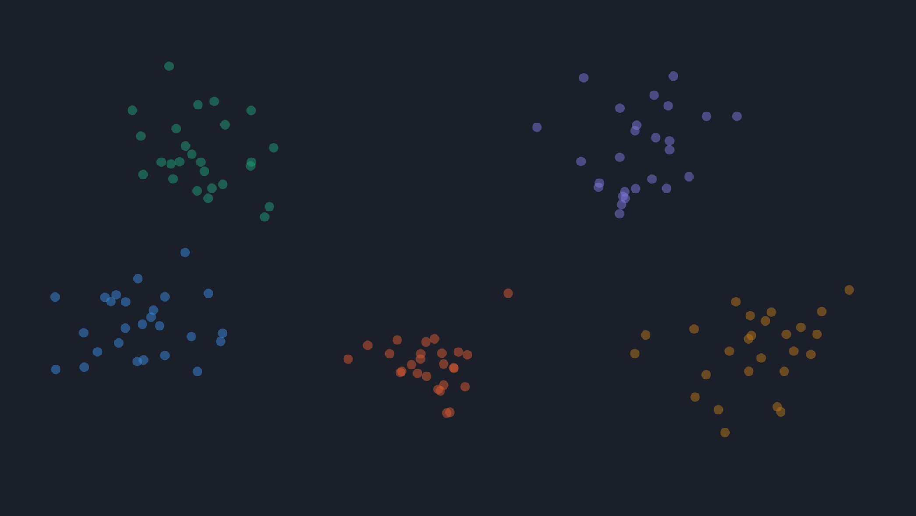
THE TAKEAWAY
The model grouped the reviews. You named the topics.
It prints a word-list per cluster. You read them, drop the incoherent ones, and write a topic name a product team can act on.
Next week: the same meaning-space points become the engine of retrieval (RAG).
ISBA 2411 · Natural Language Processing & AI · Summer 2026
14

Slide 15
APPENDIX · REFERENCES & TOOLS
Under the hood
Reimers & Gurevych (2019). Sentence-BERT: Sentence Embeddings using Siamese BERT-Networks. EMNLP. arXiv:1908.10084.
LIBRARIES
sentence-transformers
umap-learn
hdbscan
bertopic
scikit-learn
Wang et al. (2020). MiniLM: Deep Self-Attention Distillation for Task-Agnostic Compression. NeurIPS. arXiv:2002.10957.
McInnes, Healy & Melville (2018). UMAP: Uniform Manifold Approximation and Projection. arXiv:1802.03426.
Campello, Moulavi & Sander (2013). Density-Based Clustering Based on Hierarchical Density Estimates. PAKDD.
MODEL
all-MiniLM-L6-v2 (Hugging Face)
Grootendorst (2022). BERTopic: Neural topic modeling with a class-based TF-IDF procedure. arXiv:2203.05794.
TEXTBOOK
Jurafsky & Martin, SLP3, Ch. 6: Vector Semantics & Embeddings
ISBA 2411 · Natural Language Processing & AI · Summer 2026
15

